Slide 1


Accessible presentation formatting for neurodivergent populations
Elodie Carel, B.S., B.A.
University of Massachusetts Amherst
ecarel@umass.edu

Slide 2
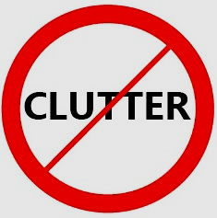

Slide content
Keep slides relatively simple and avoid too much visual clutter.
Graphics are always engaging, but need appropriate alt text.
  Basic, but not childish, symbols can be helpful for everyone to quickly take in key information about your slide.
  Alt text in PPT: right click to pull up options for any individual text box → view alt text
  → write alt text that is the same as the table content, or, if appropriate, mark your image as decorative.
  Alt text is particularly important if you are taking the highly recommended step of sharing a downloadable version of your PowerPoint.
  Background color matching of your to your slide (see clutter graphic) minimizes distractions.

Slide 3

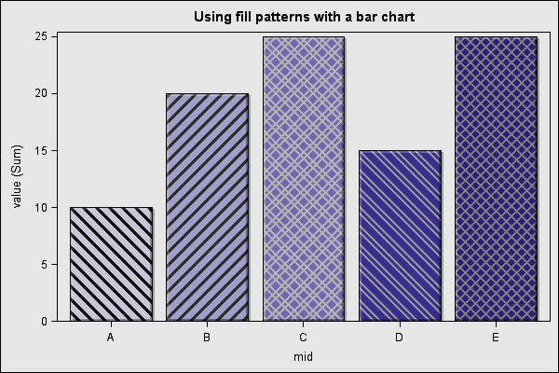
Color usage
While maintaining a 4.5:1 color contrast ratio, avoid stark contrast (e.g. black text on a white background; bright color text/graphic on almost any background).
  This is because strong contrast can create eyestrain.
  Maintaining a 4.5:1 color contrast ratio is important because neurodivergent or not, a lot of people experience some level of visual impairment.
Use an additional modality other than color to convey meaning.
  Ex: different patterns or labels on your graph.
  This is because a lot of people are color blind.
  This is especially important for red and green as a significant
  proportion of the population is red-green colorblind.

Slide 4

Font & text size
  Sans serif vs. serif
Must have: a sans-serif font.
  Sans serif font: a typeface that doesn’t have decorative
  lines or tapers at the ends of letters.
  Best practice: verdana or calibri.
    In addition to being sans serif, these fonts have good letter and word spacing for people with dyslexia.
Font size should be at least 18 point.
  Bigger, as long as it does not impair readability (ex: 100 point font) is better.
Use left-aligned text when possible.
  Left-aligned text is easier for many people with dyslexia and other neurodivergences to read than center or right-aligned text.

Slide 5
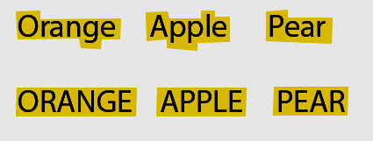
Readability
  All caps vs. lowercase
  example
Avoid blocks of all caps.
  The equal height of all letters makes them more
  difficult to differentiate from each other.
  Best practice: consider using sentence case
  for your headers as opposed to title case
  as this makes them easier for many neurodivergent people to read.
Use 1.5 spacing.
  Increases readability. 1.15 is also better than the default 1.0 spacing, but it will create barriers for more people than 1.5 will.
  2.0 is technically best practice, but many neurodivergent people find the lines to be too far apart.

Slide 6

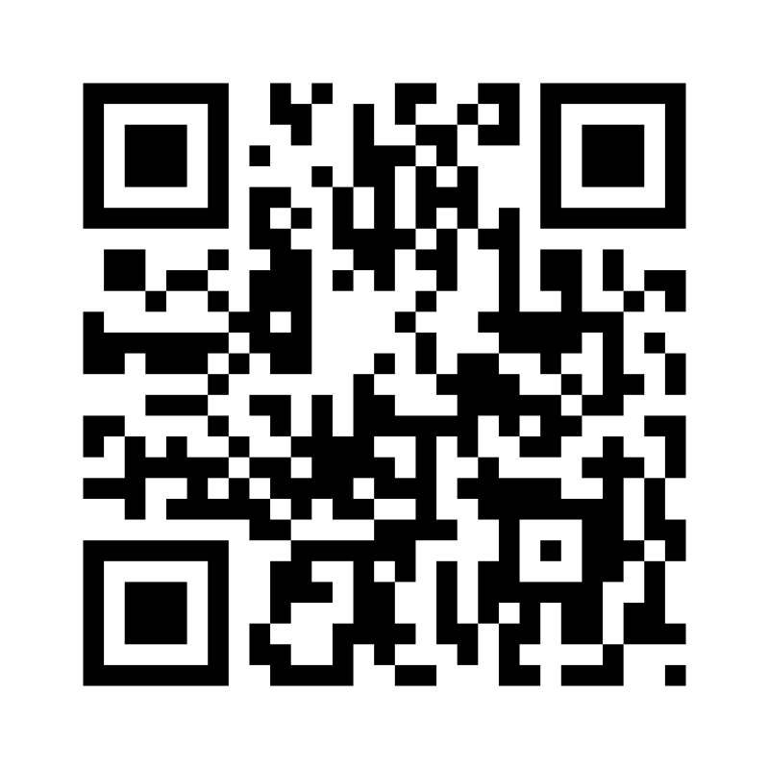
Multiple modalities of processing information
Include spoken descriptions of relevant text or graphics that appear on your slide as part of your presentation.
  Reading in overstimulating conference environments can be a challenge for some. By including descriptions in your oral presentation, you will increase the amount of information one can access.
Link and QR code to a downloadable public version of slides so someone can listen along or pull up in a way more accessible to them.
  Allows one to revisit the presentation at their own pace, make any adjustments to format to make the presentation accessible to them, and listen to the slides with their screenreader* if they use one.
  *Note: screenreader usage amongst neurodivergent individuals is way more common that most people realize.

